Slide 1
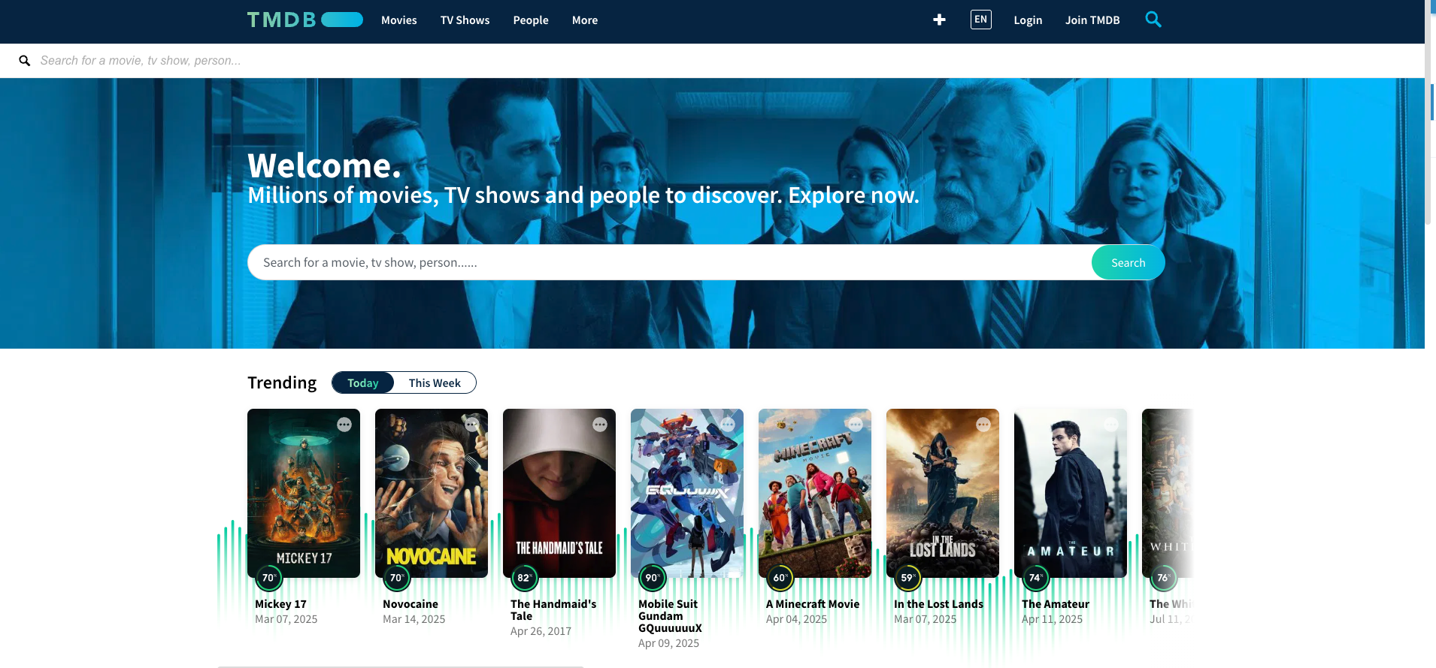

Python Project: TMDB Analysis
By Jorge A. Martinez

Slide 2
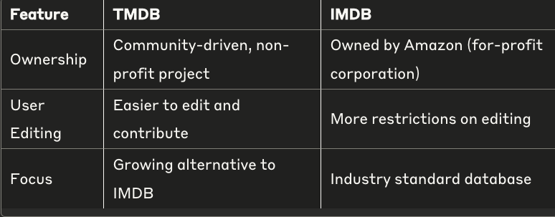
TMDB: The Movie Database
TMDB WEBSITE SIZE:
Difference Between IMDB and TMDB: IMDB (Internet Movie Database) and TMDB (The Movie Database) are both online databases for movie and TV show information, but TMDB is a community-driven, non-profit project, while IMDB is owned by a for-profit corporation, Amazon. This is why it is harder to edit IMDB than TMDB.

Slide 3
TMDB 2024 Kaggle Dataset
Kaggle dataset pulled from TMDB API
Dataset is updated daily (according to Kaggle)
Dataset Dimensions: 1,200,365 rows x 24 columns
Since so many presentations focus on IMDB, here I am focusing on TMDB.

Slide 4

Research Questions
How do Ratings and Budget affect ROI?
How has movie runtime and genre popularity changed over time?
Notes:
Say you are going to weave in geographic information over time:

Slide 5
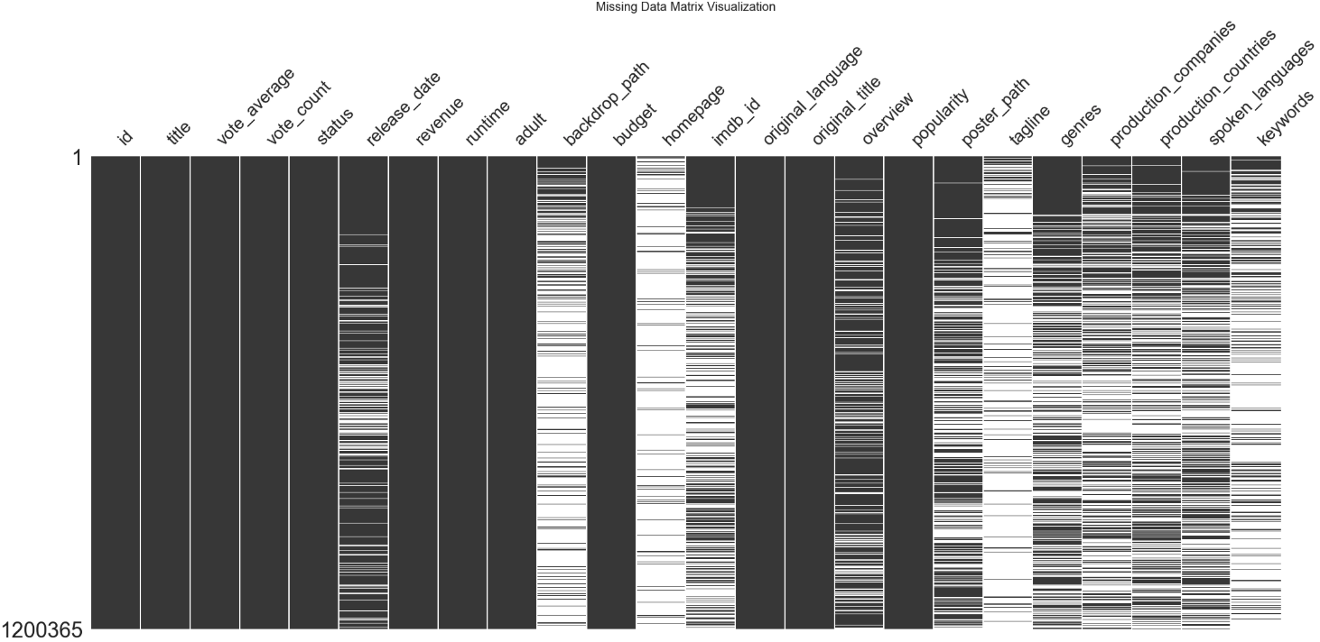
Missing Values
Notes:
This is actually misleading, because:

Slide 6
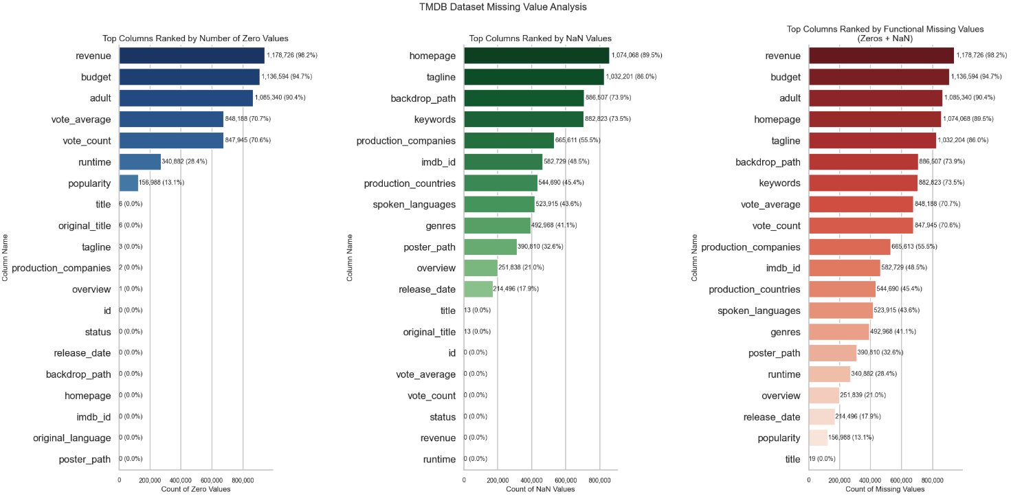

Slide 7
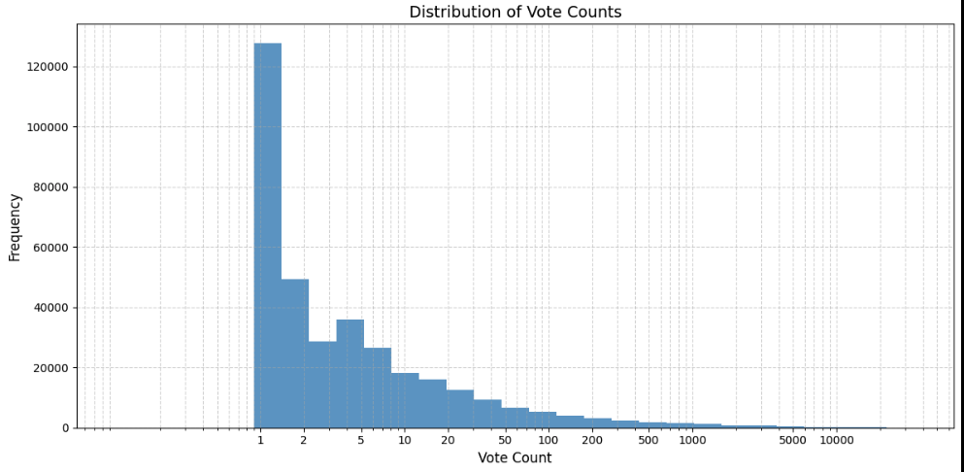
What is vote count?

Slide 8
Finances

Slide 9
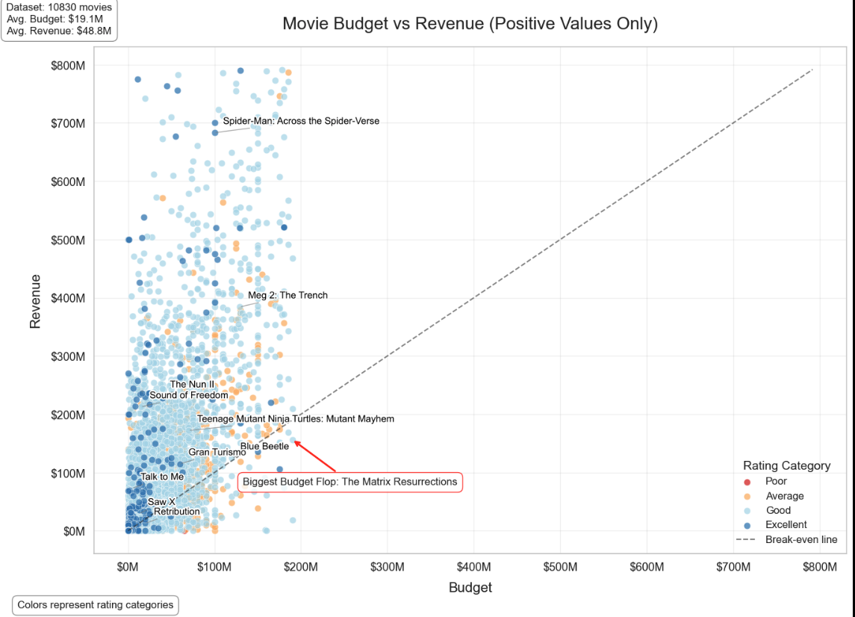
This is a subset of the dataset (1%) that is filtered so that each title has both positive revenue and budget and makes sure that movies with missing rating category values are removed.
Notes:
Explain Rating

Slide 10
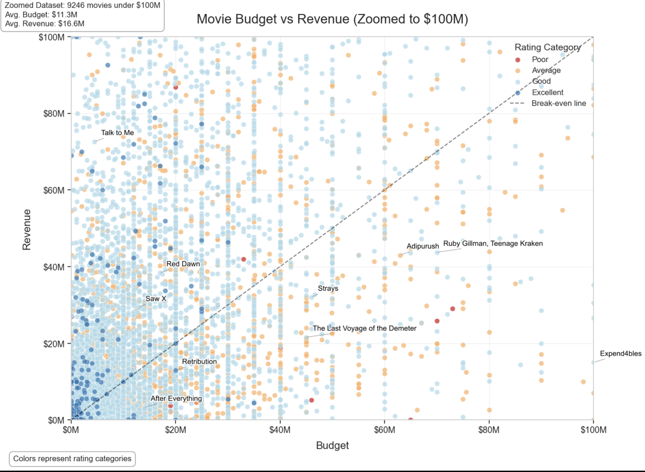
Most movies are here in this zoomed in version.
In order to better visualize, I went ahead and did 4 separate visuals by category with the same dimensions below this..
Notes:
Below:

Slide 11
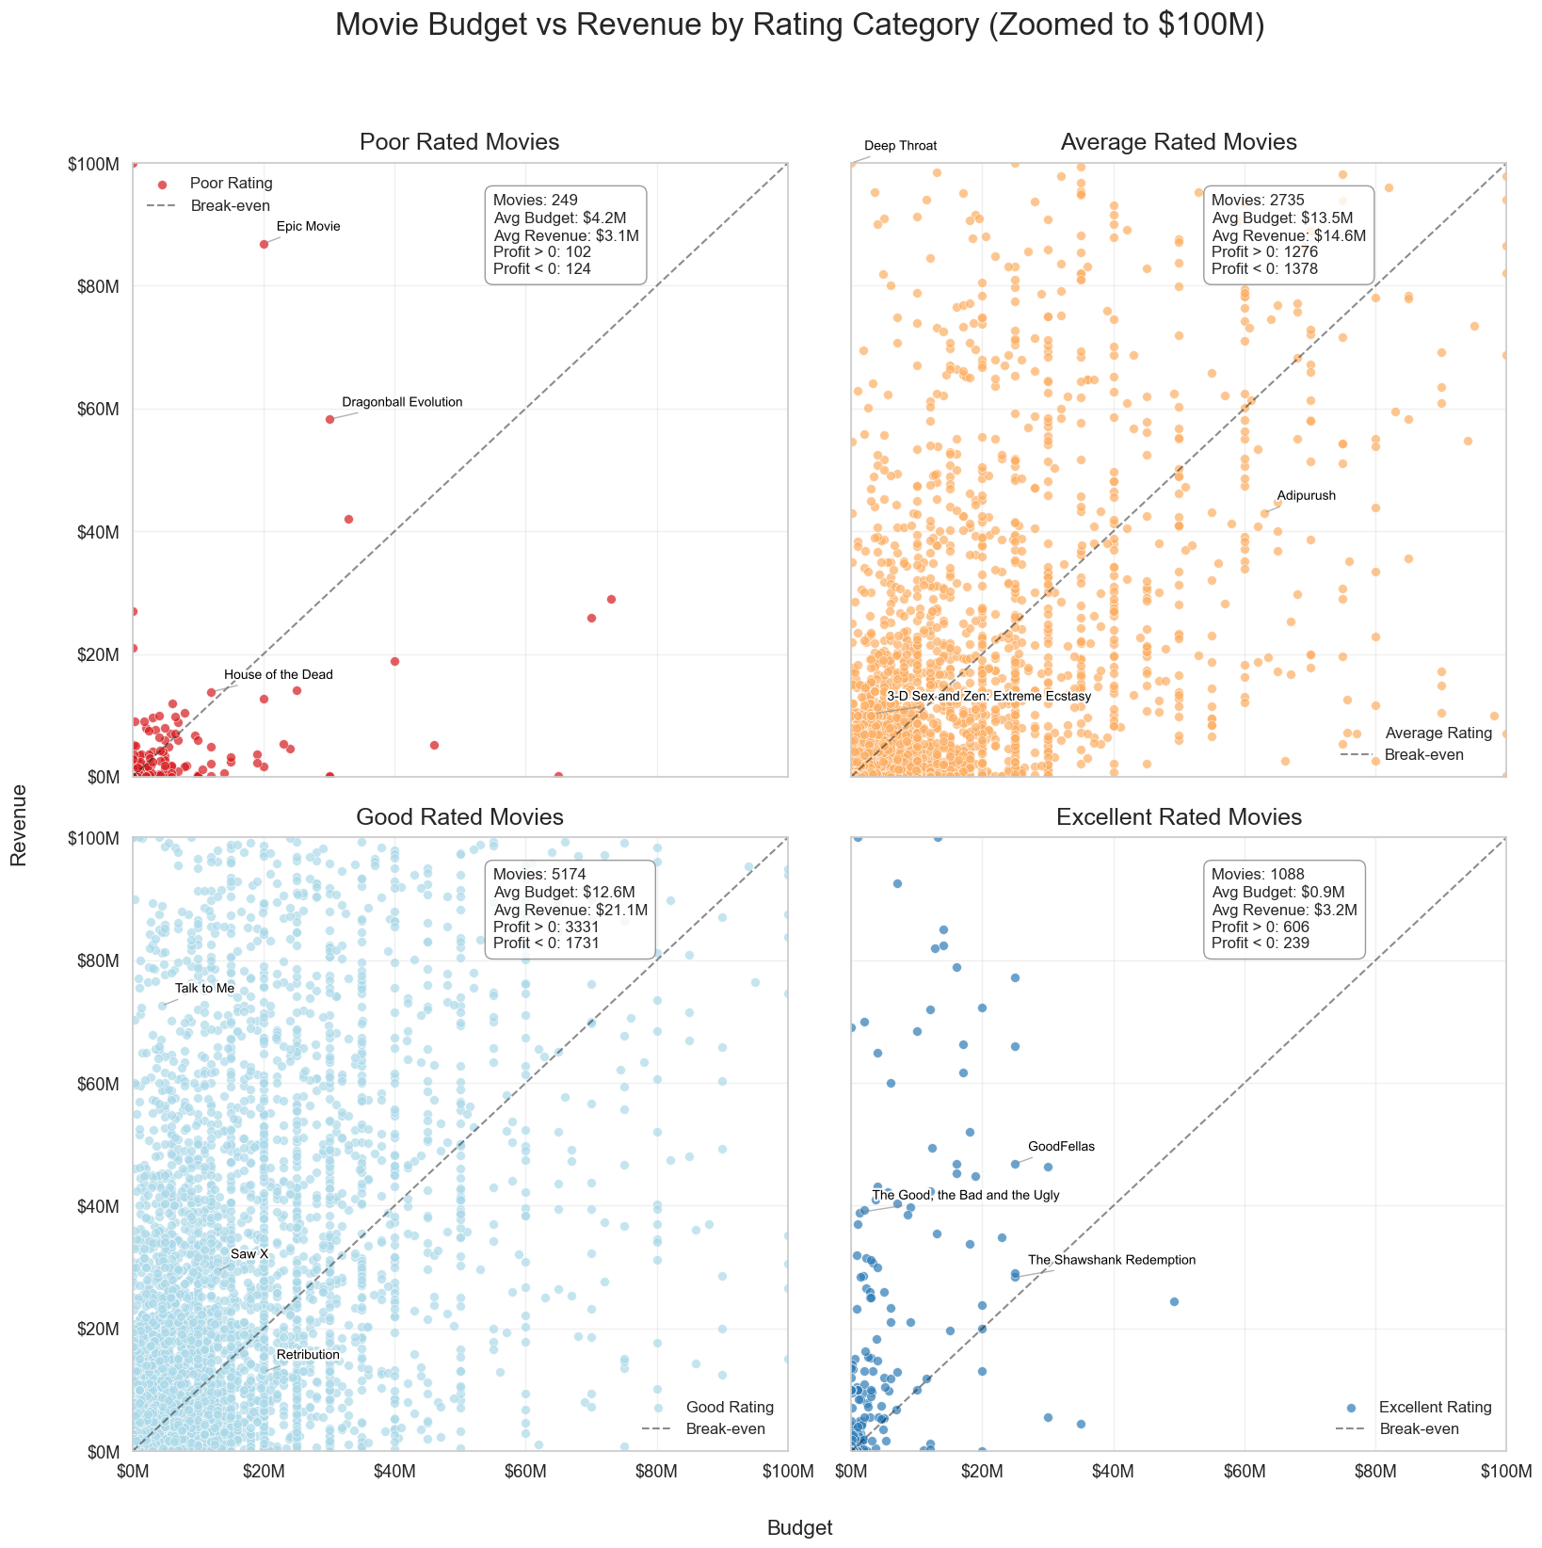
Notes:
Focus on growth from poor to excellent and uniqueness of excellent.

Slide 12
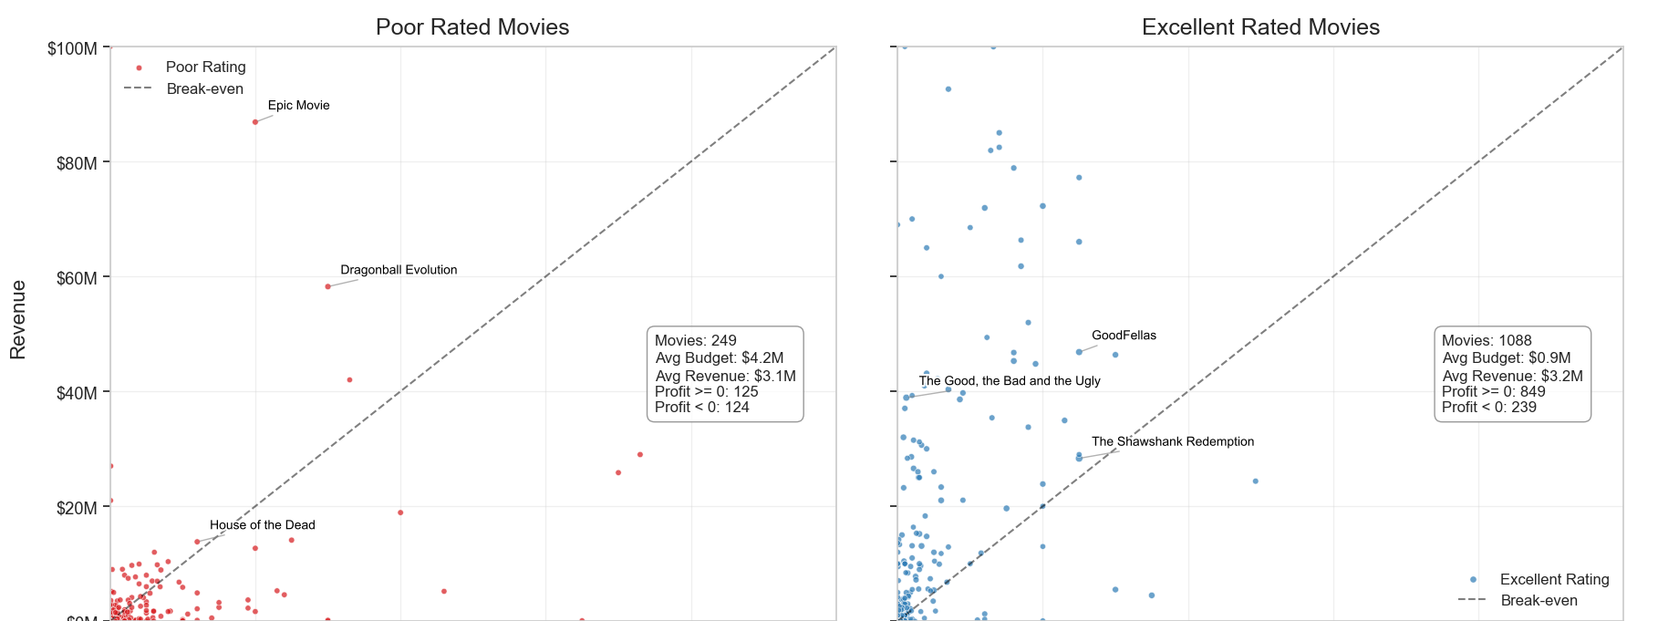
Notes:
This pattern suggests that excellent-rated films are more efficient with their money. They're able to produce higher-quality content with less budget, and the market responds positively to that quality, generating good revenue relative to what was spent.
Poor-rated films, on the other hand, seem to be throwing more money at productions that audiences don't respond well to. The higher budgets don't translate to better quality or audience reception, resulting in many of them failing to recoup their costs.
This illustrates an interesting phenomenon in filmmaking: higher budgets don't necessarily correlate with better quality. In fact, constraints sometimes force filmmakers to be more creative and focused, resulting in better-received films despite (or perhaps because of) lower budgets.

Slide 13
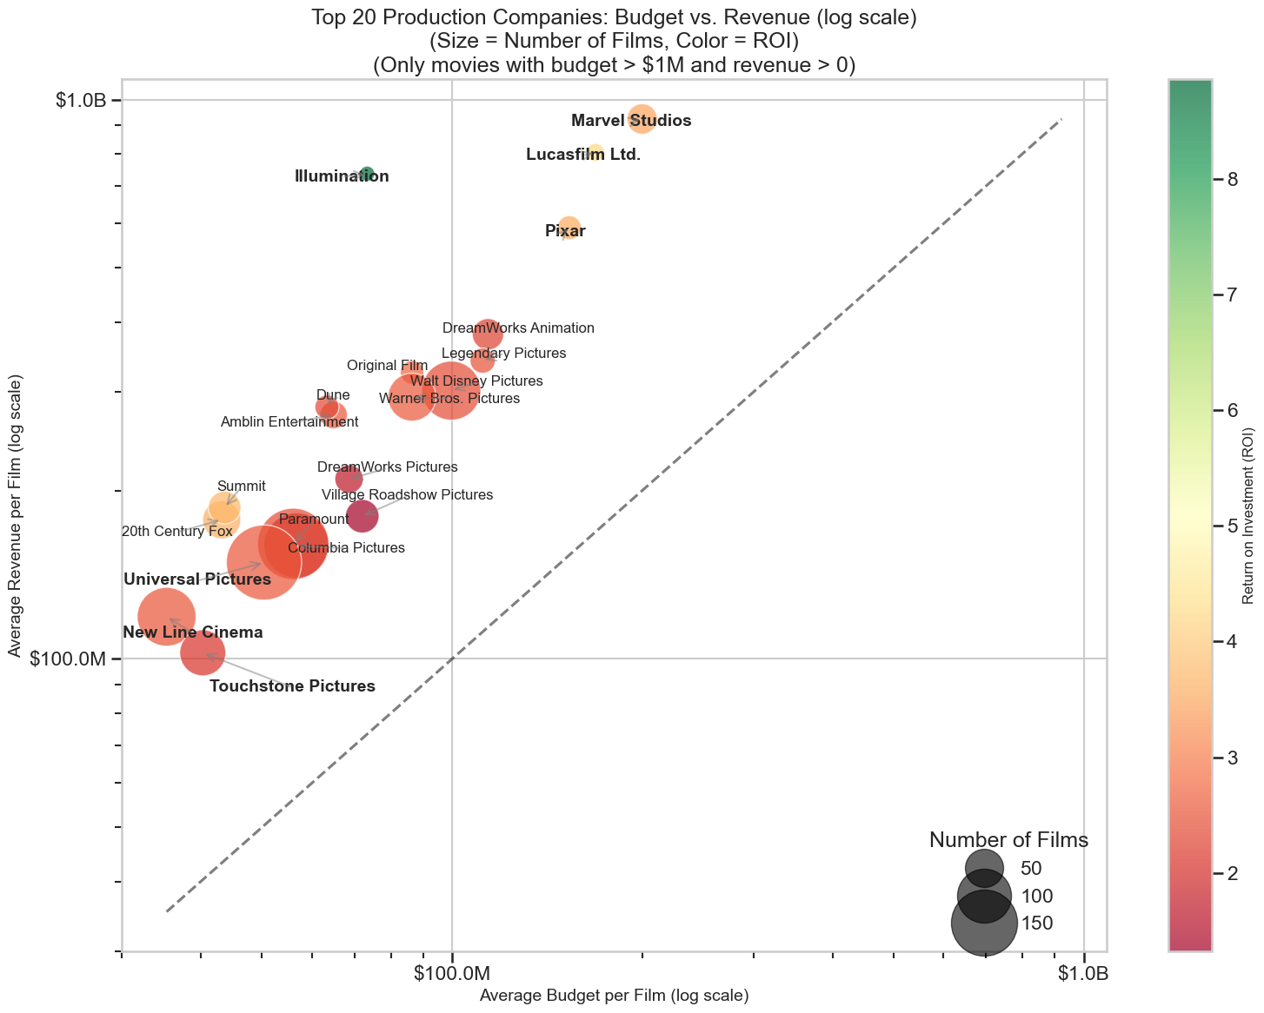
Notes:
Below:
Focus on size of bubbles in relation to ROI.

Slide 14
Geography

Slide 15
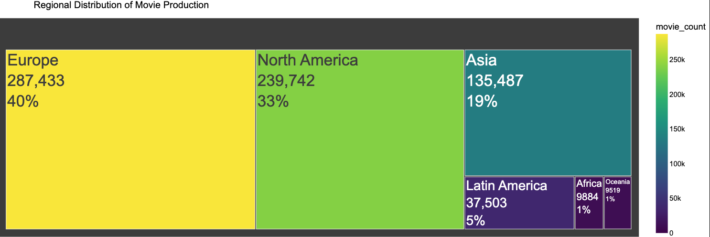

Slide 16
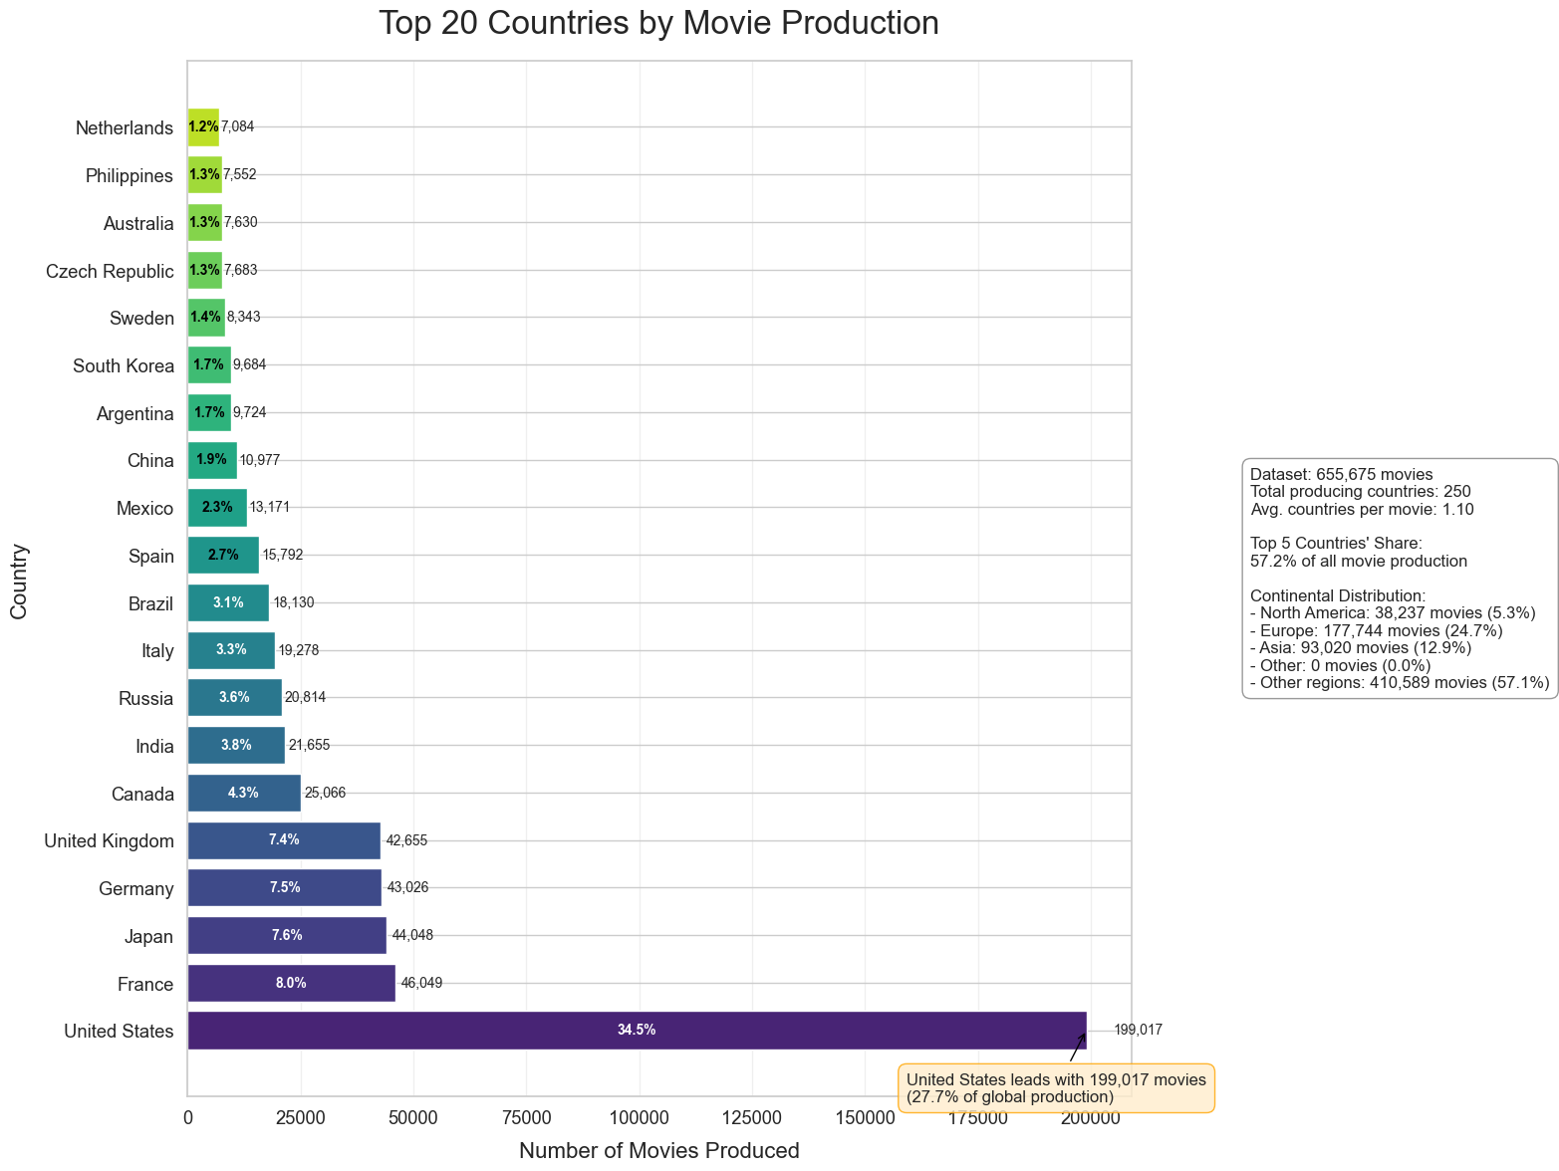
Notes:
Discuss how contintents compare against each other and how this is a subset of the dataset because of missing values (50%)

Slide 17
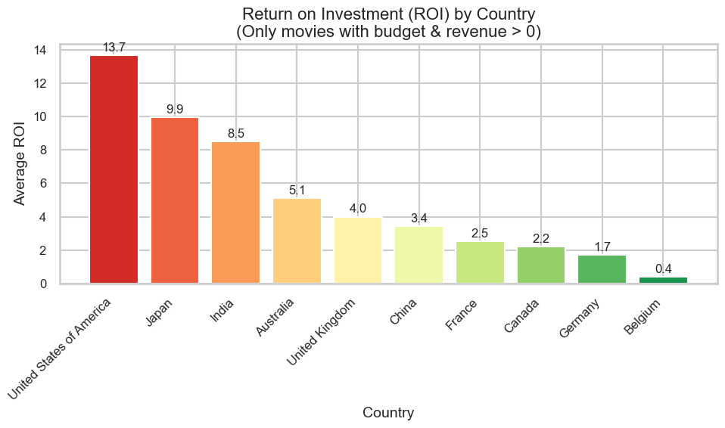
ROI of 1.0 means a 100% return on investment. If you invested $100 million in a movie, you got back your $100 million plus another $100 million in profit (total revenue of $200 million).
ROI of 0.0 represents breaking even - you got back exactly what you invested with no profit or loss.
ROI of 2.0 means a 300% return (you tripled your money).
Negative ROI values mean the movie lost money.
Notes:
Below:

Slide 18
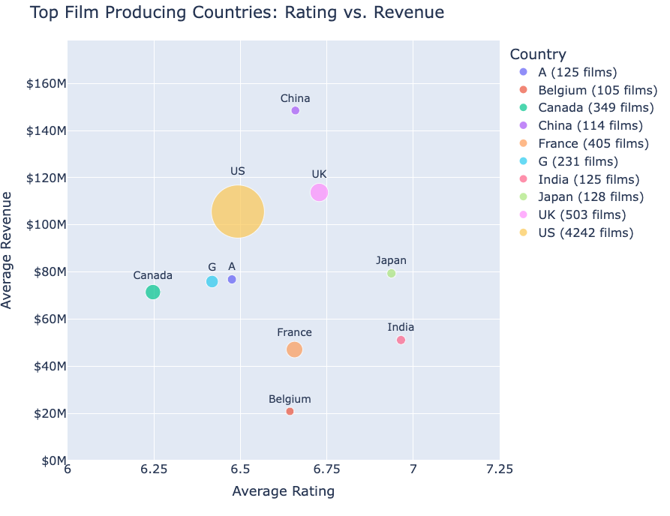
Australia
Germany

Slide 19
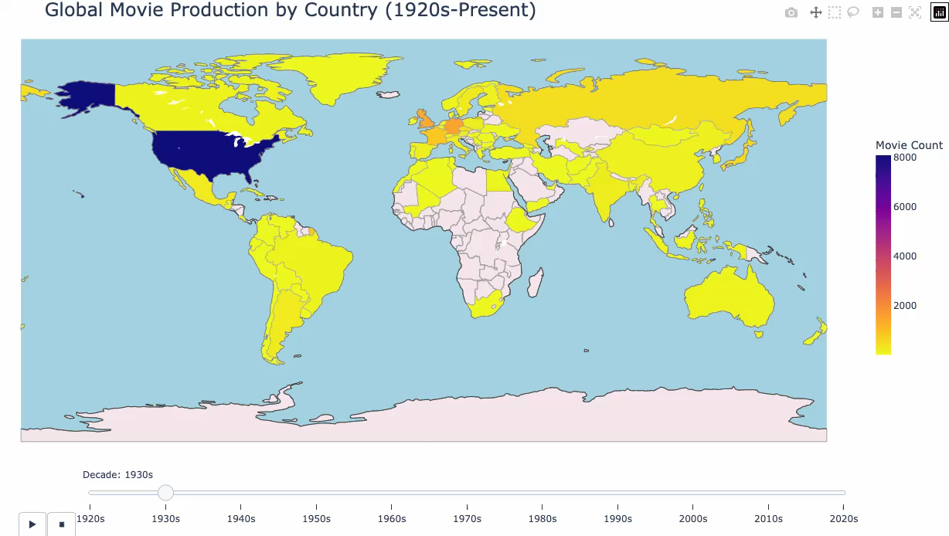
Animation

Slide 20
RUNTIME and GENRE

Slide 21
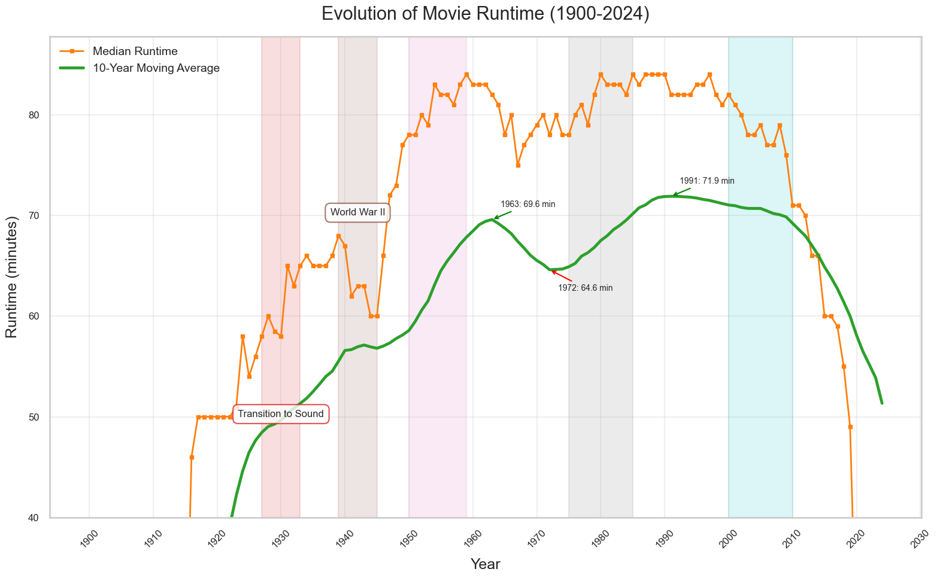
Movie Runtime Statistics
Analysis of 677,517 movies from 1900 to 2024
This data seems misleading, so I isolated theatrical from non-theatrical in the next slide.
Notes:
Movie Runtime Statistics
Analysis of 677517 movies from 1900 to 2024

Slide 22
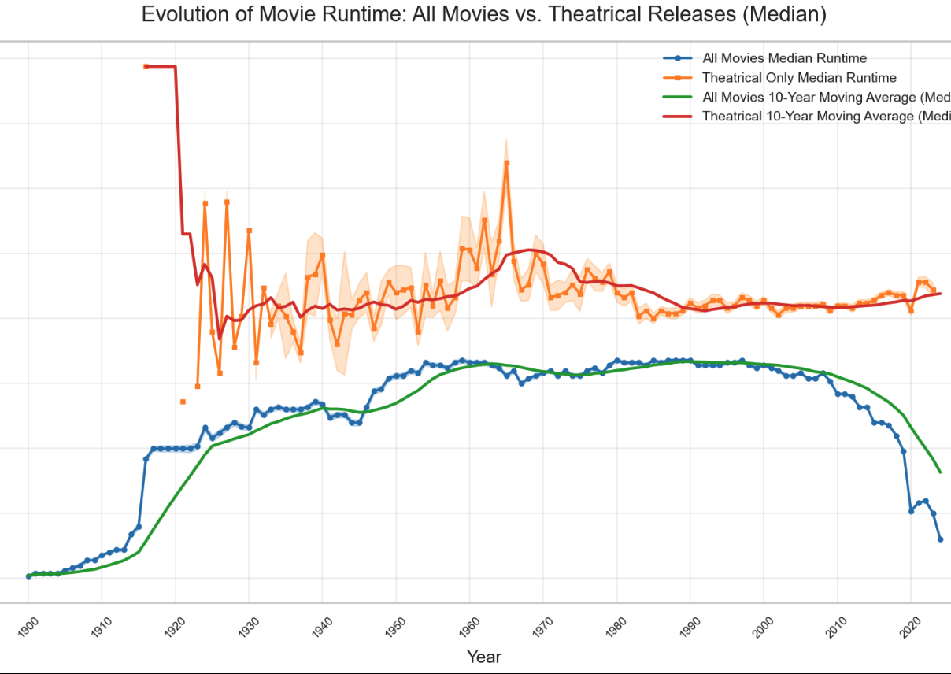
Filters:
zero or negative runtime values
Have unreasonably long runtimes (over 300 minutes)
Have missing release year values
It filters out years with fewer than 10 movies to ensure statistical significance
Theatrical Filter
Popularity threshold: Movies with a vote_count greater than 100 are considered theatrical. This suggests movies that received significant audience attention.
Revenue threshold: Movies with a revenue greater than $100,000 are included as theatrical releases.
Budget threshold: Movies with a budget greater than $100,000 are considered theatrical.
Notes:
This confirms that the runtime decline isn't because theatrical movies are getting shorter - it's because the TMDB dataset includes an increasing proportion of short-form content after 2010. This coincides with:
The rise of streaming platforms that produce shorter content
International Content
The explosion of short films and web content being added to the database
The growth of TMDB itself (founded in 2008), which likely began including more non-theatrical content as it expanded

Slide 23
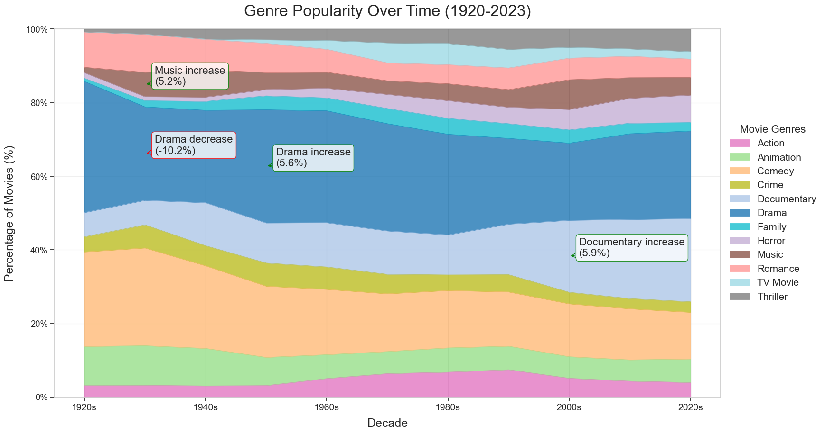
Notes:
Here's the text from the image:
Dominant Genre by Decade: 1920s: Drama (35.6%) 1930s: Comedy (26.6%) 1940s: Drama (25.1%) 1950s: Drama (30.8%) 1960s: Drama (30.4%) 1970s: Drama (29.2%) 1980s: Drama (27.4%) 1990s: Drama (23.3%) 2000s: Drama (21.0%) 2010s: Drama (23.3%) 2020s: Drama (23.9%)
Overall Genre Trends (1920s to 2020s):
Growing Genres: Documentary: +16.0% Horror: +5.9% Thriller: +5.4%
Declining Genres: Romance: -4.6% Drama: -11.8% Comedy: -13.0%
Stacked Area Chart

Slide 24
Conclusion
Rating is a bigger indicator of ROI than budget.
Countries with less film production can have higher ratings and roi on average, like Japan and India.
Theatrical Film runtime has plateaued over the last 4 decades, while non-theatrical film runtime has decreased in the last 2 decades.
Genres like Horror, Thriller, and Documentary have increased overall, while more classic genres like comedy, drama, and romance have decreased overall.

Slide 25
Future work
Develop a robust missing value strategy across multiple sources. Ingesting data from IMDB, for example.
If we can identify what information we have before the Movie’s release, we can create a predictive model using pre-release features that can inform potential ROI.
Create a dashboard for country view, so that you can see film production, Ratings, and ROI compared with peer countries interactively.
Notes:
Keep adding ideas to future work.
Digital competition idea
More countries for bubble? Rating treemap, like the genre treemap
Line graphs of countries over time, maybe per continent?

Slide 26
Q & A

Slide 27
Fin!

